Slide 1
Week 15 project management
Perform quality assurance

Slide 2
Perform Quality Assurance
Perform Quality Assurance is the process of auditing the quality requirements and the results from quality
control measurements to ensure that appropriate quality standards and operational definitions are used. The key
benefit of this process is that it facilitates the improvement of quality processes. The inputs, tools and techniques,
and outputs of this process are depicted in Figure 8-8. Figure 8-9 depicts the data flow diagram of the process.
The quality assurance process implements a set of planned and systematic acts and processes defined within the project’s quality management plan. Quality assurance seeks to build confidence that a future output or an unfinished output, also known as work in progress, will be completed in a manner that meets the specified requirements and expectations. Quality assurance contributes to the state of being certain about quality by preventing defects through the planning processes or by inspecting out defects during the work-in-progress
stage of implementation. Perform Quality Assurance is an execution process that uses data created during Plan
Quality Management (Section 8.1) and Control Quality (Section 8.3) processes.

Slide 3
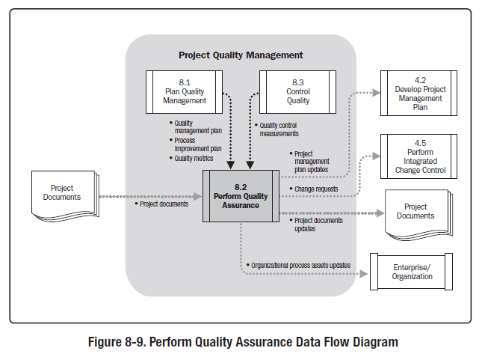

Slide 4
In project management, the prevention and inspection aspects of quality assurance should have a demonstrable influence on the project. Quality assurance work will fall under the conformance work category in the cost of quality framework.
A quality assurance department, or similar organization, often oversees quality assurance activities. Quality assurance support, regardless of the unit’s title, may be provided to the project team, the management of the performing organization, the customer or sponsor, as well as other stakeholders not actively involved in the work of the project. Perform Quality Assurance also provides an umbrella for continuous process improvement, which is an iterative means for improving the quality of all processes. Continuous process improvement reduces waste and eliminates activities that do not add value. This allows processes to operate at increased levels of efficiency and effectiveness.

Slide 5
1 Perform Quality Assurance: Inputs
1 Quality Management Plan
The quality management plan describes the quality assurance and continuous process improvement approaches for the project.
2 Process Improvement Plan
The project’s quality assurance activities should be supportive of and consistent with the performing organization’s process improvement plans.
3 Quality Metrics
The quality metrics provide the attributes that should be measured and the allowable variations.
4 Quality Control Measurements
Quality control measurements are the results of control quality activities. They are used to analyze and evaluate the quality of the processes of the project against the standards of the performing organization or the requirements specified. Quality control measurements can also compare the processes used to
create the measurements, and validate actual measurements to determine their level of correctness.
5 Project Documents
Project documents may influence quality assurance work and should be monitored within the context of a
system for configuration management.

Slide 6
2 Perform Quality Assurance: Tools and Techniques
1 Quality Management and Control Tools
The Perform Quality Assurance process uses the tools and techniques of the Plan Quality Management and Control Quality processes. In addition, other tools that are available include (see also Figure 8-10):
• Affinity diagrams. The affinity diagram is similar to mind-mapping techniques in that they are used
to generate ideas that can be linked to form organized patterns of thought about a problem. In project
management, the creation of the WBS may be enhanced by using the affinity diagram to give structure
to the decomposition of scope.
• Process decision program charts (PDPC). Used to understand a goal in relation to the steps for getting
to the goal. The PDPC is useful as a method for contingency planning because it aids teams in anticipating
intermediate steps that could derail achievement of the goal.
• Interrelationship digraphs. An adaptation of relationship diagrams. The interrelationship digraphs
provide a process for creative problem solving in moderately complex scenarios that possess intertwined
logical relationships for up to 50 relevant items. The interrelationship digraph may be developed from
data generated in other tools such as the affinity diagram, the tree diagram, or the fishbone diagram.
• Tree diagrams. Also known as systematic diagrams and may be used to represent decomposition
hierarchies such as the WBS, RBS (risk breakdown structure), and OBS (organizational breakdown
structure). In project management, tree diagrams are useful in visualizing the parent-to-child relationships
in any decomposition hierarchy that uses a systematic set of rules that define a nesting relationship.

Slide 7
Tree diagrams can be depicted horizontally (such as a risk breakdown structure) or vertically (such as a team hierarchy or OBS). Because tree diagrams permit the creation of nested branches that terminate into a
single decision point, they are useful as decision trees for establishing an expected value for a limited number of dependent relationships that have been diagramed systematically.
• Prioritization matrices. Identify the key issues and the suitable alternatives to be prioritized as a set of decisions for implementation. Criteria are prioritized and weighted before being applied to all available
alternatives to obtain a mathematical score that ranks the options.
• Activity network diagrams. Previously known as arrow diagrams. They include both the AOA (Activity on Arrow) and, most commonly used, AON (Activity on Node) formats of a network diagram. Activity
network diagrams are used with project scheduling methodologies such as program evaluation and review technique (PERT), critical path method (CPM), and precedence diagramming method (PDM).
• Matrix diagrams. A quality management and control tool used to perform data analysis within the organizational structure created in the matrix. The matrix diagram seeks to show the strength of relationships between factors, causes, and objectives that exist between the rows and columns that form the matrix. Affinity Diagram PDPC Interrelationship Digraph Tree Diagrams Prioritization Matrices Network Diagrams Matrix Diagrams

Slide 8
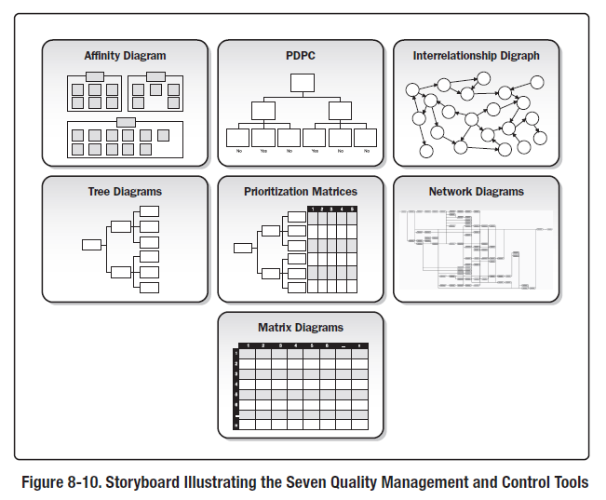

Slide 9
2 Quality Audits
A quality audit is a structured, independent process to determine if project activities comply with organizational and project policies, processes, and procedures. The objectives of a quality audit may include:
• Identify all good and best practices being implemented;
• Identify all nonconformity, gaps, and shortcomings;
• Share good practices introduced or implemented in similar projects in the organization and/or industry;
• Proactively offer assistance in a positive manner to improve implementation of processes to help the team raise productivity; and
• Highlight contributions of each audit in the lessons learned repository of the organization. The subsequent effort to correct any deficiencies should result in a reduced cost of quality and an increase in sponsor or
customer acceptance of the project’s product. Quality audits may be scheduled or random, and may be conducted by internal or external auditors. Quality audits can confirm the implementation of approved change requests including updates, corrective actions, defect repairs, and preventive actions.
3 Process Analysis
Process analysis follows the steps outlined in the process improvement plan to identify needed improvements. This analysis also examines problems experienced, constraints experienced, and non-value-added activities identified during process operation. Process analysis includes root cause analysis—a specific technique used to identify a problem, discover the underlying causes that lead to it, and develop preventive actions.

Slide 10
3 Perform Quality Assurance: Outputs
1 Change Requests
Change requests are created and used as input into the Perform Integrated Change Control process (Section 4.5)
to allow full consideration of the recommended improvements. Change requests are used to take corrective action,
preventive action, or to perform defect repair.
2 Project Management Plan Updates
Elements of the project management plan that may be updated include, but are not limited to:
• Quality management plan
• Scope management plan
• Schedule management plan , and
• Cost management plan .
3 Project Documents Updates
Project documents that may be updated include, but are not limited to:
• Quality audit reports,
• Training plans, and
• Process documentation.
4 Organizational Process Assets Updates
Elements of the organizational process assets that may be updated include, but are not limited to, the organization’s quality standards and the quality management system.

